Slide 1
Workshop: Agentic AI with DeepSeek
16th August 2025
By Duarte OC

Slide 2
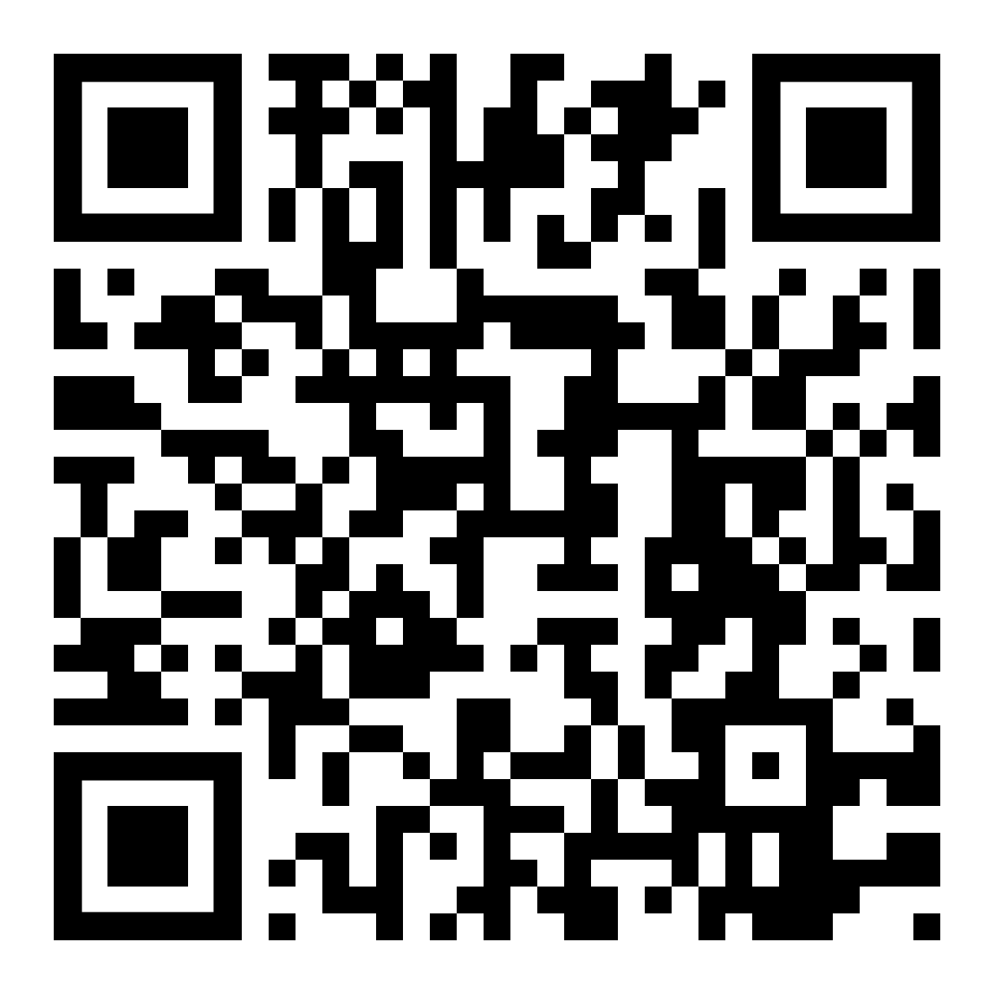
Before we start..
In this workshop, we will learn about building workflows and agents with DeepSeek
Prerequisites: Intermediate knowledge of Python (we assume you have some level of experience with it)
Duration: 60 mins including Q&A
When you’re ready, scan the barcode to get started!
GitHub link: github.com/duarteocarmo/deepseek-agents-workshop

